Slide 1
More on Discipleship
Session 6: The Book Colossians
By: Louie Giglio
02/22/2024
Gyro
Email: sjaros@verizon.net
Notes:
- Introduce your self. Carl Madsen
- Tell the Joke about Albert Einstein
- Open up in Prayer
1

Slide 2
Recap
Session 1 – Col 1:1 -14 George Murphy
Session 2 – Col 1:15 -23 David Pond
Session 3 – Col 1:24 –29 Jim Prock
Col 2:1-5
Session 4 – Col 2:6-15 Pastor Angel
Session 5 – Col 2:16-23 Carl Madsen
Session 6 – Col 3:1-17 Steve (gyro)
Next Week:
Session 7 Michael St. Clair
Session 8 George Murphy
Notes:
- Recap where we are, and where we are going
- This is an 8 week study course, and now how 5 more weeks left.
- Talk a little about next year studies

Slide 3
Session Big Idea
Since we are alive in Christ, we can take off the old self and put on the new self, which affects our mindset, our actions toward each other, and how we engage in corporate worship.

Slide 4
Things to look for in this session
What three words summarize this section of Colossians?
What does it mean to take off the old self and put on the new self?
How can we do all things in the name of Jesus? How does that truth apply to all areas of life?
Is there a proper order of putting on “the whole armor of God vs the new self?”

Slide 5
Roll the Video
Notes:
- Get Hunter to play Session 3 - “One with Christ”
- Discipleship Explored: One with Christ by Barry Cooper

Slide 6
You Now Have Two Residences
You have a new identity in your new reality
You are operating in a new life
You are living in overlapping worlds
Earthly home
New home in Christ
Col 3: 4 “ When Christ who is our life appears, then you also will appear with Him in glory.”
Notes:
- Get Hunter to play Session 3 - “One with Christ”
- Discipleship Explored: One with Christ by Barry Cooper

Slide 7
How is “Glory” Defined?
Glory = Noun
Praise, honor, magnificence
Renown – a distinguished asset
A state of great gratification or exaltation
Great beauty and splendor
“The glory that was Greece, the grandeur that was Rome.” E. A. Poe
A ring or spot of light
A halo appearing around the shadow of an object
Notes:
- Get Hunter to play Session 3 - “One with Christ”
- Discipleship Explored: One with Christ by Barry Cooper

Slide 8
Other Earthly Images of God’s Glory
Notes:
- Get Hunter to play Session 3 - “One with Christ”
- Discipleship Explored: One with Christ by Barry Cooper

Slide 9
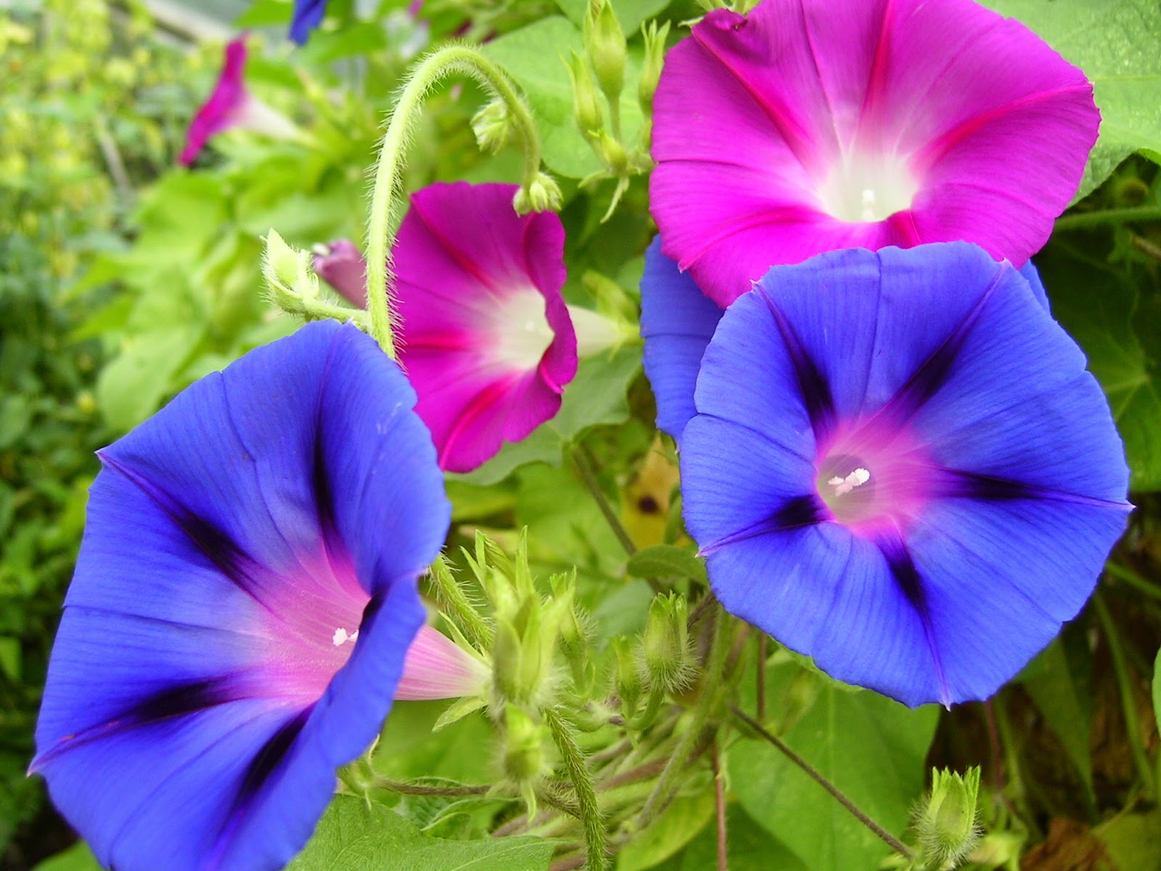
Morning Glory Flowers
Notes:
- Get Hunter to play Session 3 - “One with Christ”
- Discipleship Explored: One with Christ by Barry Cooper

Slide 11
Morning Glory Clouds (also Roll Clouds)

Slide 14
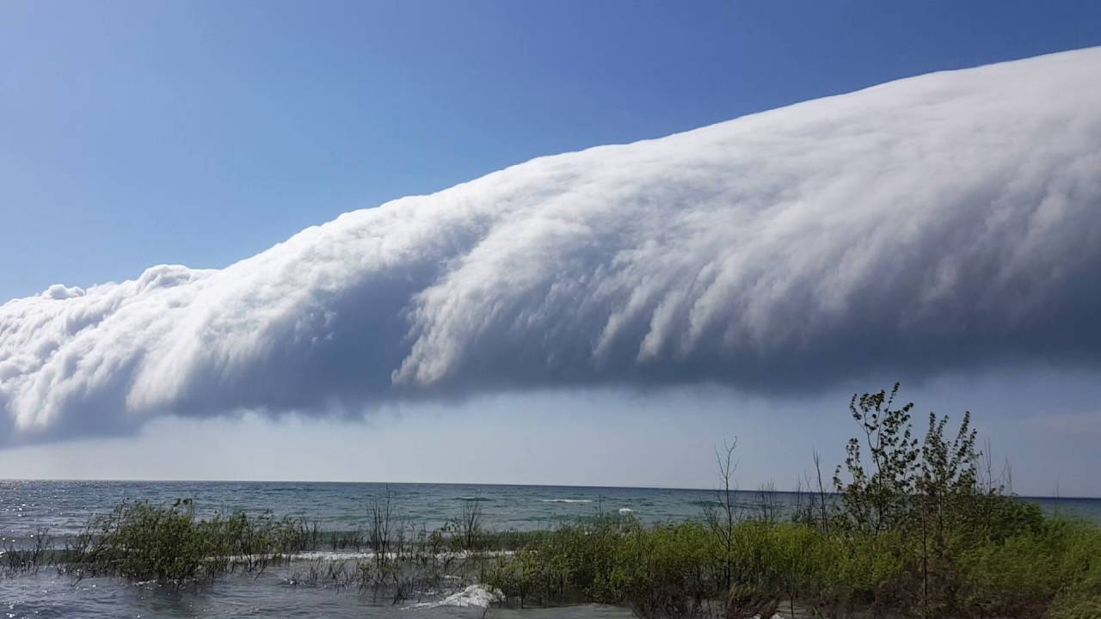
Notes:
- Get Hunter to play Session 3 - “One with Christ”
- Discipleship Explored: One with Christ by Barry Cooper

Slide 15
Putting On Your “New Attire”
First LOVE
COMPASSION
KINDNESS
HUMILITY
GENTLENESS
PATIENCE
An must always be ready and able to FORGIVE

Slide 16
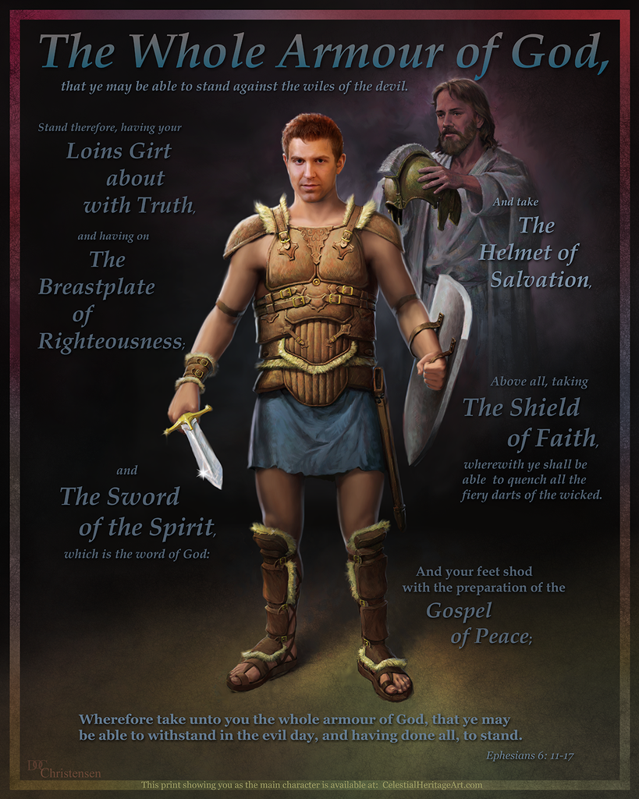

Slide 17
Clothing Ourselves With Behavior Befitting of God’s People
Paul wants to dress us in both these ways but what do we put on first?
What happens when we put on the whole armor over an old self?
Can only a new self wear the whole armor?
Does the armor need to be worn a certain way, i.e. properly, strictly, in some order, etc.?

