Slide 1
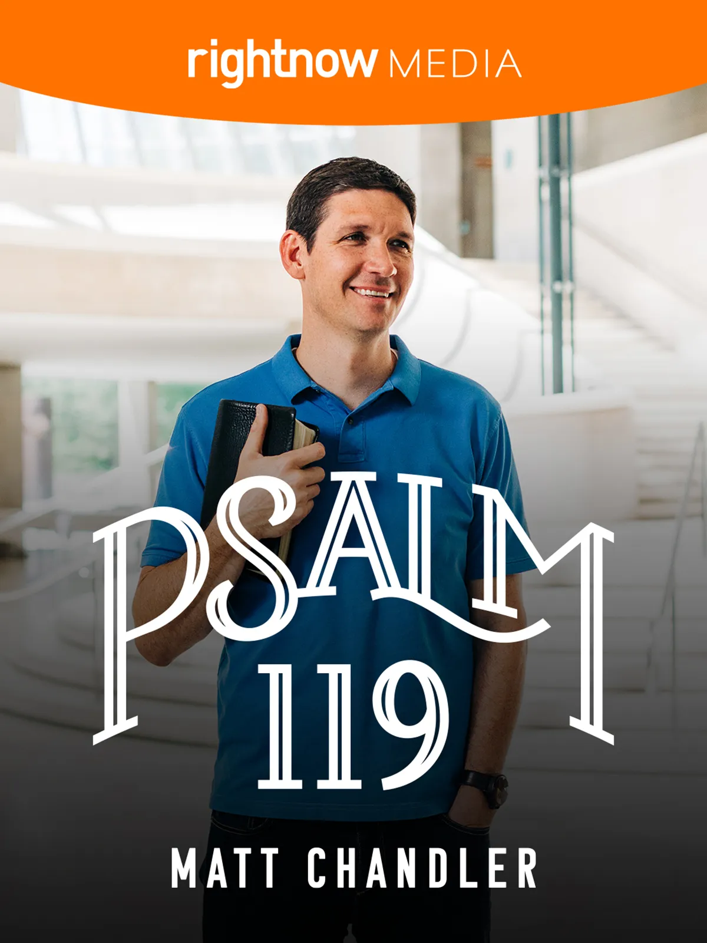

Slide 2
SUMMARY Psalm 119
Even the most mature believers face dark nights of the soul. During those times God seems distant, his Word feels dry, and the vibrant intimacy we knew before seems absent leaving us wondering, “Where is the Lord in this?”
In Psalm 119, Matt Chandler aims to introduce viewers to the words of King David who experienced similar seasons of life. Serving as the anchor for the study,
Psalm 119 demonstrates the power of God’s Word in the lives of believers and its ability to provide a warm blanket for the soul.

Slide 3
OVERVIEW Psalm 119
Matt described Psalm 119 as a shadow of what has come in the person and work of Jesus Christ. We do not gain the blessed life through works of our own, but through the finished work of Jesus Christ, which is credited to us by faith.
A disciplined reading of God’s Word will ultimately lead us to the Word made flesh—Jesus.
VIDEO

Slide 4
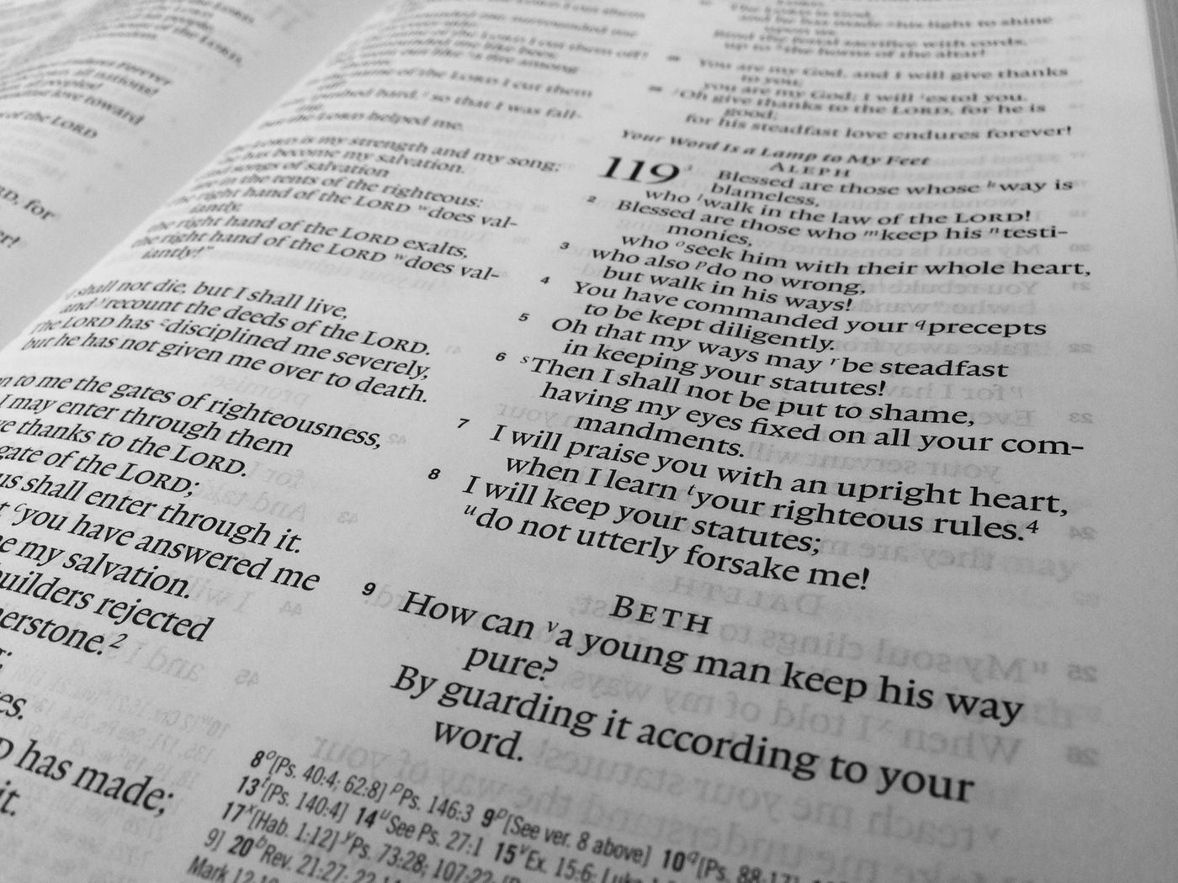
Session 1 Psalm 119:1–16
1. How familiar are you with Psalm 119?
2. What from Matt’s session deepened your understanding of the background and content of the psalm?

Slide 5
Session 1 Psalm 119:1–16
When you consider the phrase “blessed life” what comes to mind? What do you consider important elements of being blessed?
If verses 1–8 describes the blessed life, David point out as marks of the blessed life.
Verses 9–16 expresses David’s desire to understand how to experience the blessed life.
CROSSTALK
1. How does Jesus describe the “blessed life”? What similarities or differences do you see between the Beatitudes and Psalm 119?
2. Based on these verses, would you say you are living the blessed life today? Why or why not?

Slide 6
Session 1 Psalm 119:1–16
The “blessing” of God comes to us through faith in the perfect life, death, and resurrection of Jesus—not by any work of our own. If we have any hope of growing in faith, we have to be honest about where we are today.

Slide 7
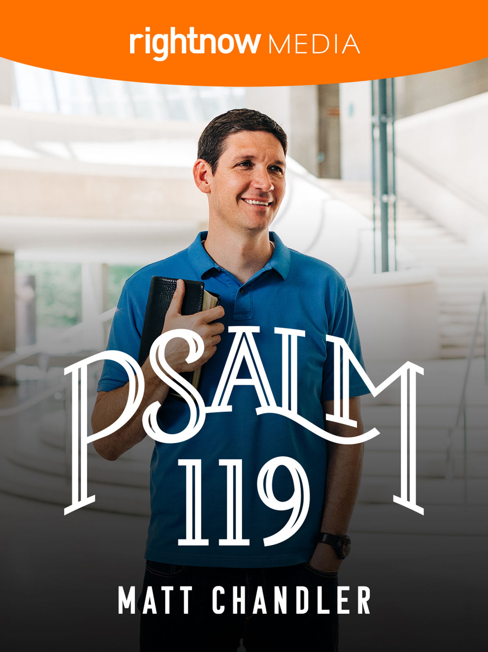
LAST WORD
The only way we get anywhere in life is through an honest understanding of our starting point.
This is just as true for road trips as it is for our relationship with Jesus Christ.
He knows us better than we know ourselves so pretending to be something we are not is a futile effort.

Slide 8
FINAL LAST WORD
Faith means trusting in the promises of God, which are yours through belief in Christ.
One of those promises is that there is no more condemnation for those who have believed in the death and resurrection of Jesus (Rom. 8:1).
Faith is acting on that promise, confessing where you are today, and allowing God to cleanse you and lead you step by step into new life with Him.
Act on that truth today believing that God delights in you even when you stumble.

